Slide 1
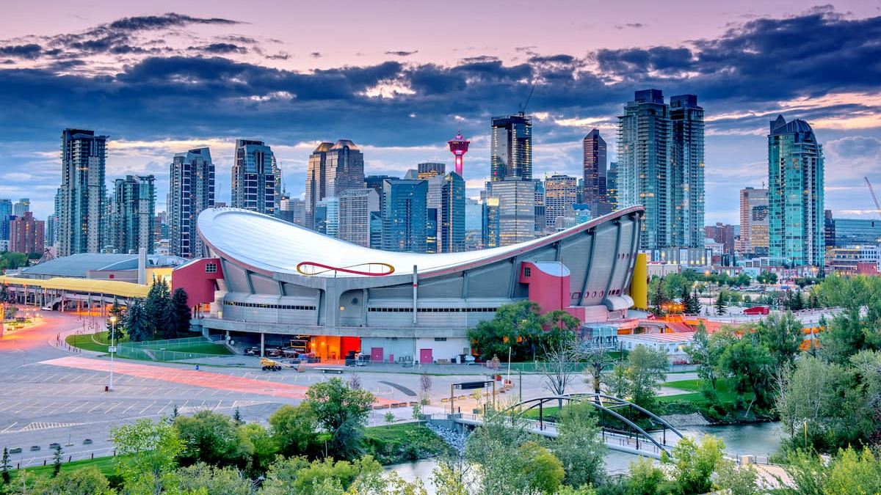
Battle of Neighbourhoods: Neighbourhood Analysis of the City of Calgary
By: Ayda Takehei

Slide 2
Business Problem
Background
Questions:
What is the safest neighborhood?
What are the top venues in a neighborhood?
Which neighborhood is less populated, which is more?
Objective:
To analyze neighborhoods throughout Calgary and help people determine the most suitable one according to their needs and interests
Calgary, a gateway to the beautiful Rocky Mountains, was ranked the most livable city in North America thus experiencing high population growth. One of the biggest challenges in moving to a new city is finding a suitable home.

Slide 3
Data
Data Required:
List of Calgary neighborhoods and their population densities
Geographical coordinates of each neighbourhood
Data of the top 100 venues that are within a 500m radius from each neighborhood marker
List of Calgary Neighbourhood crime data
Sources of Data:
Wikipedia page
Python GeoPy library.
Foursquare API
‘Open Calgary’ website

Slide 4
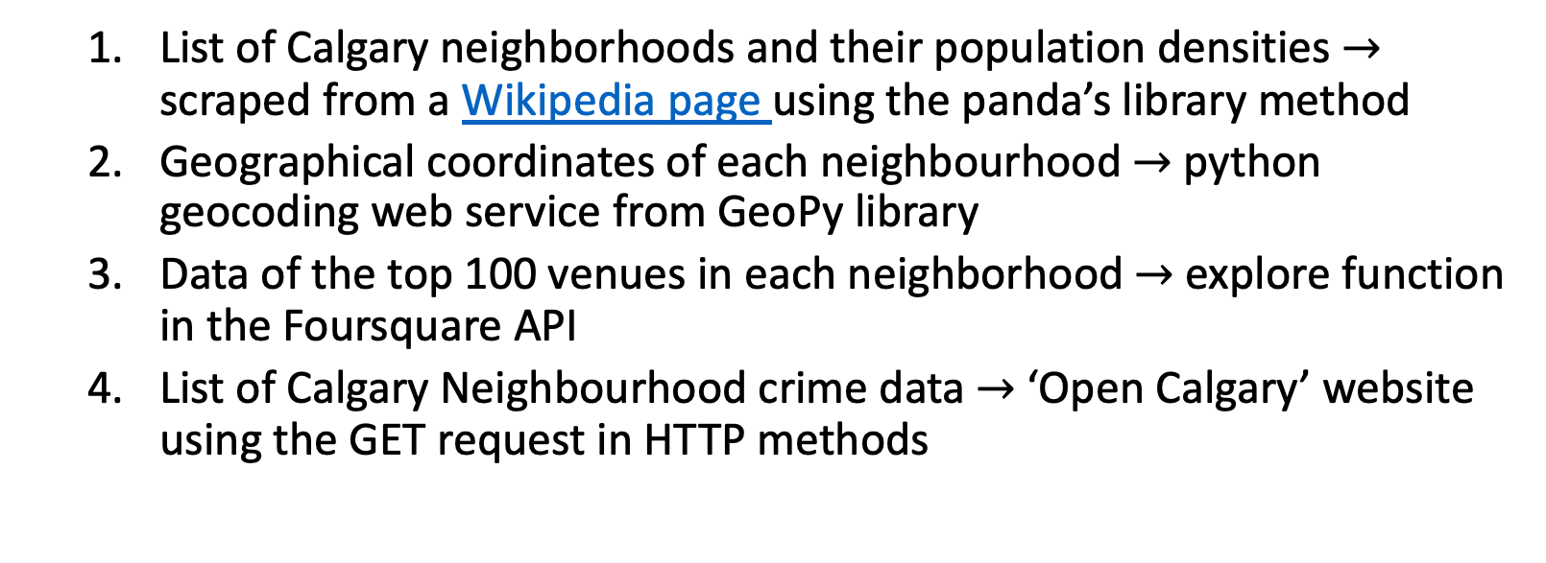
Methodology
List of Calgary neighborhoods and their population densities$→$ scraped from a Wikipedia page using the panda’s library method
Geographical coordinates of each neighbourhood $→$python geocoding web service from GeoPy library
Data of the top 100 venues in each neighborhood $→$explore function in the Foursquare API
List of Calgary Neighbourhood crime data $→$‘Open Calgary’ website using the GET request in HTTP methods

Slide 5
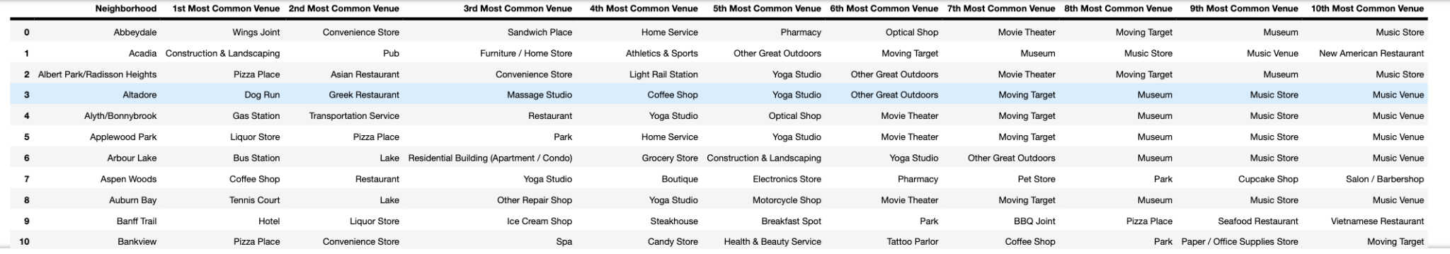
Data Analysis: One-hot Encoding
To get a grasp of concepts in each neighbourhood the venue's data is organized into unique categories through one-hot encoding

Slide 6
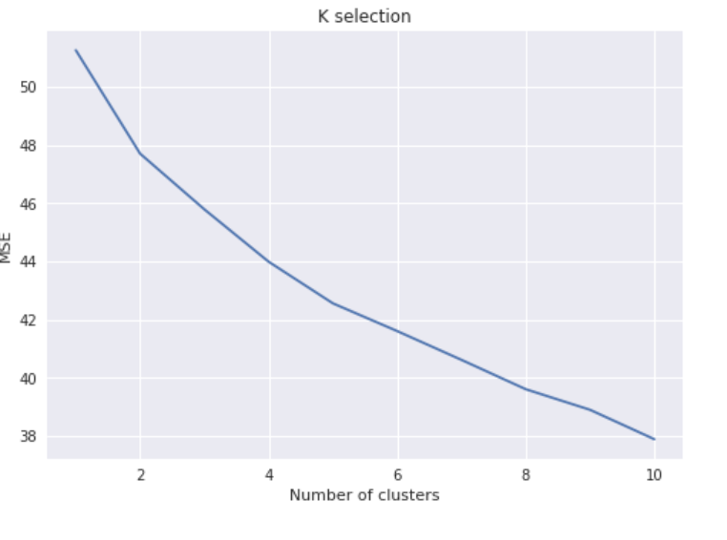
Data Analysis: Machine Learning Algorthm
K-means Clustering
An unsupervised machine learning algorithm used to analyze and cluster a set of unlabelled data
The algorithm looks for a fixed number of clusters (k), a data point that is in the center of a cluster
Selection of k:
Using the elbow method in the mean squared error vs number of cluster graph, the k value is found to be 2
Low k value of 2 indicates large clusters with less granularity

Slide 7
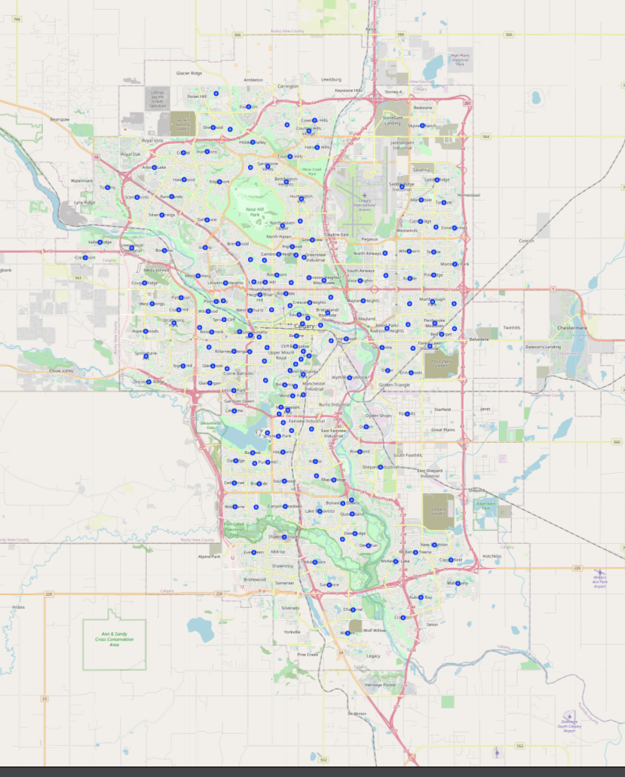
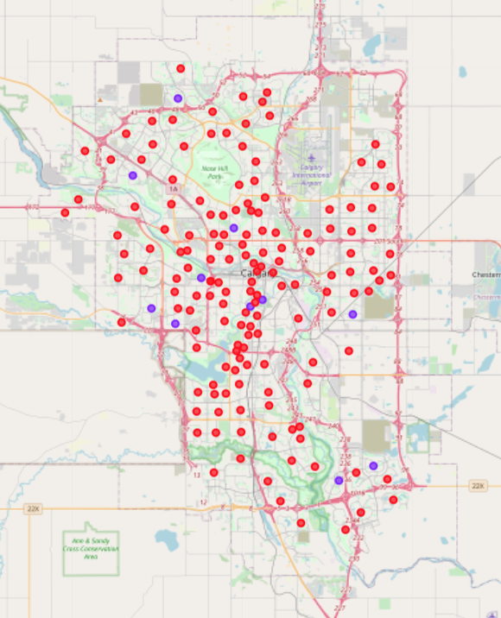
Results: Geographical location
Map of the city of Calgary with neighbourhood coordinates superimposed on top.
Map of the city of Calgary with clusters color-coded and superimposed on top. .

Slide 8
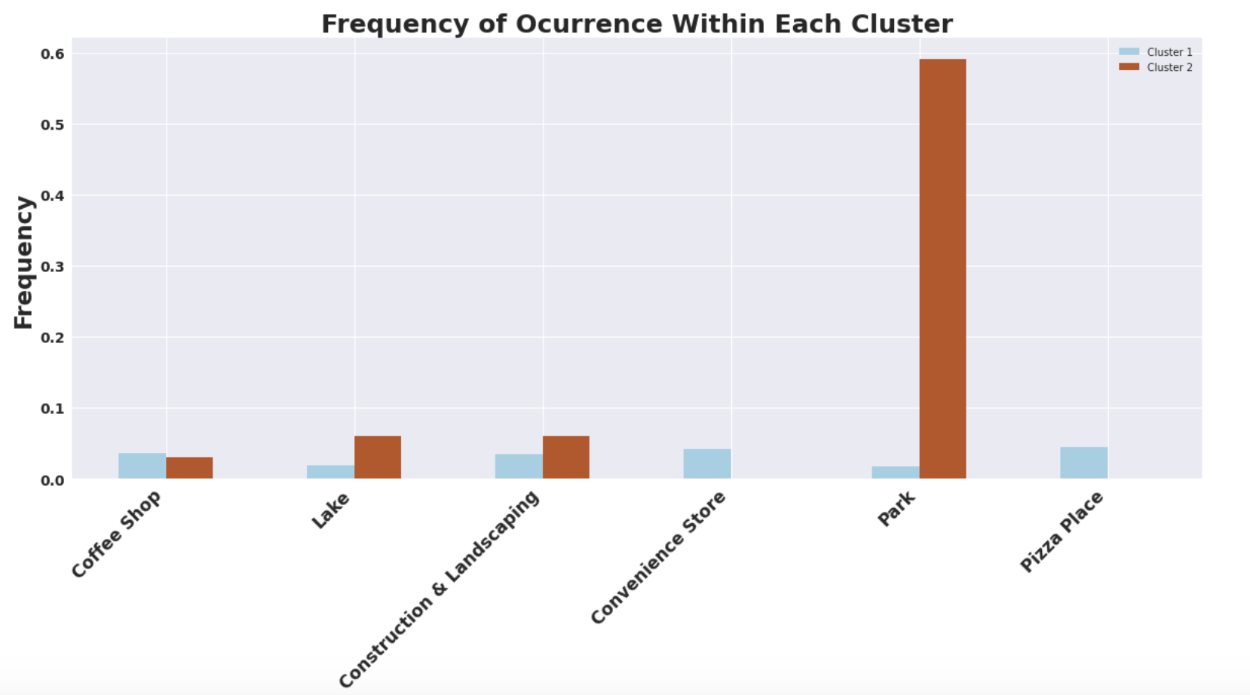
Results: Venue Visualization
Cluster 1: highly versatile with a wide variety of restaurants, cafes, recreational services, entertainment services and parks
Cluster 2: consists mostly of parks with entertainment services, lakes and recreation coming in second.

Slide 9
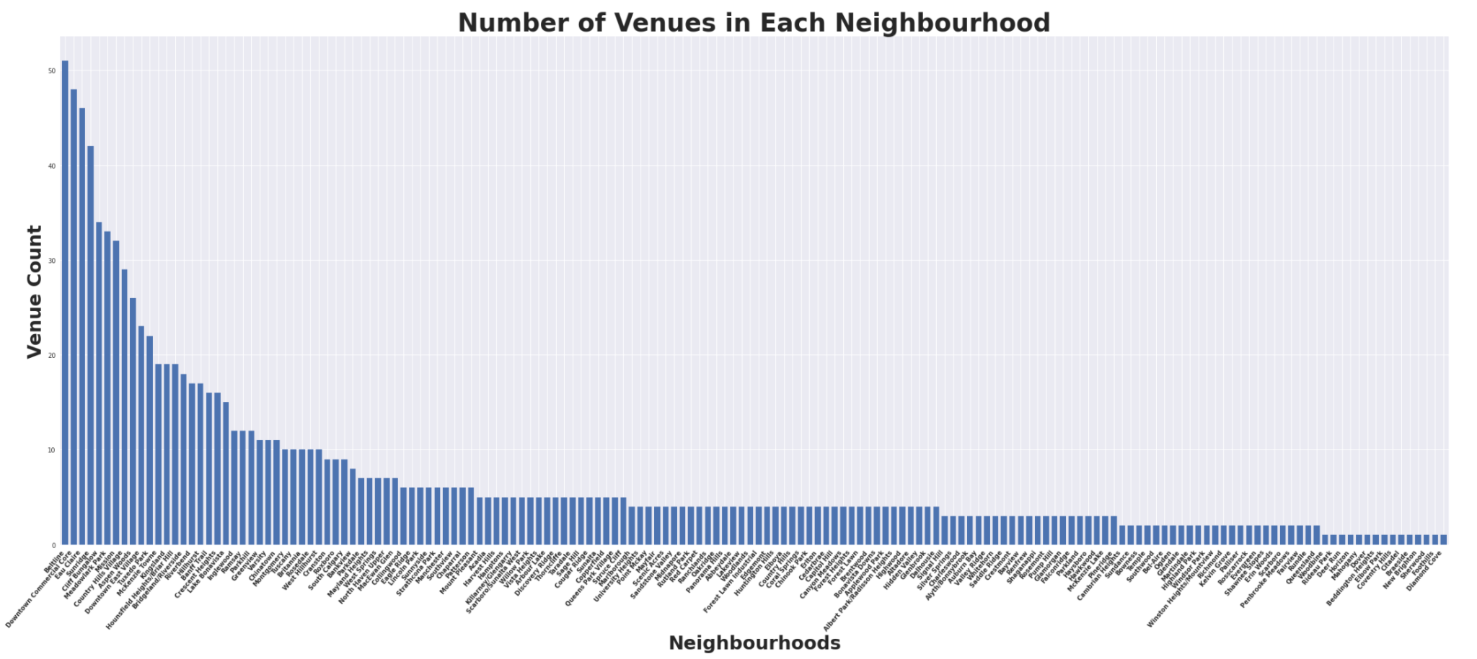
Results: Venue Visualization

Slide 10
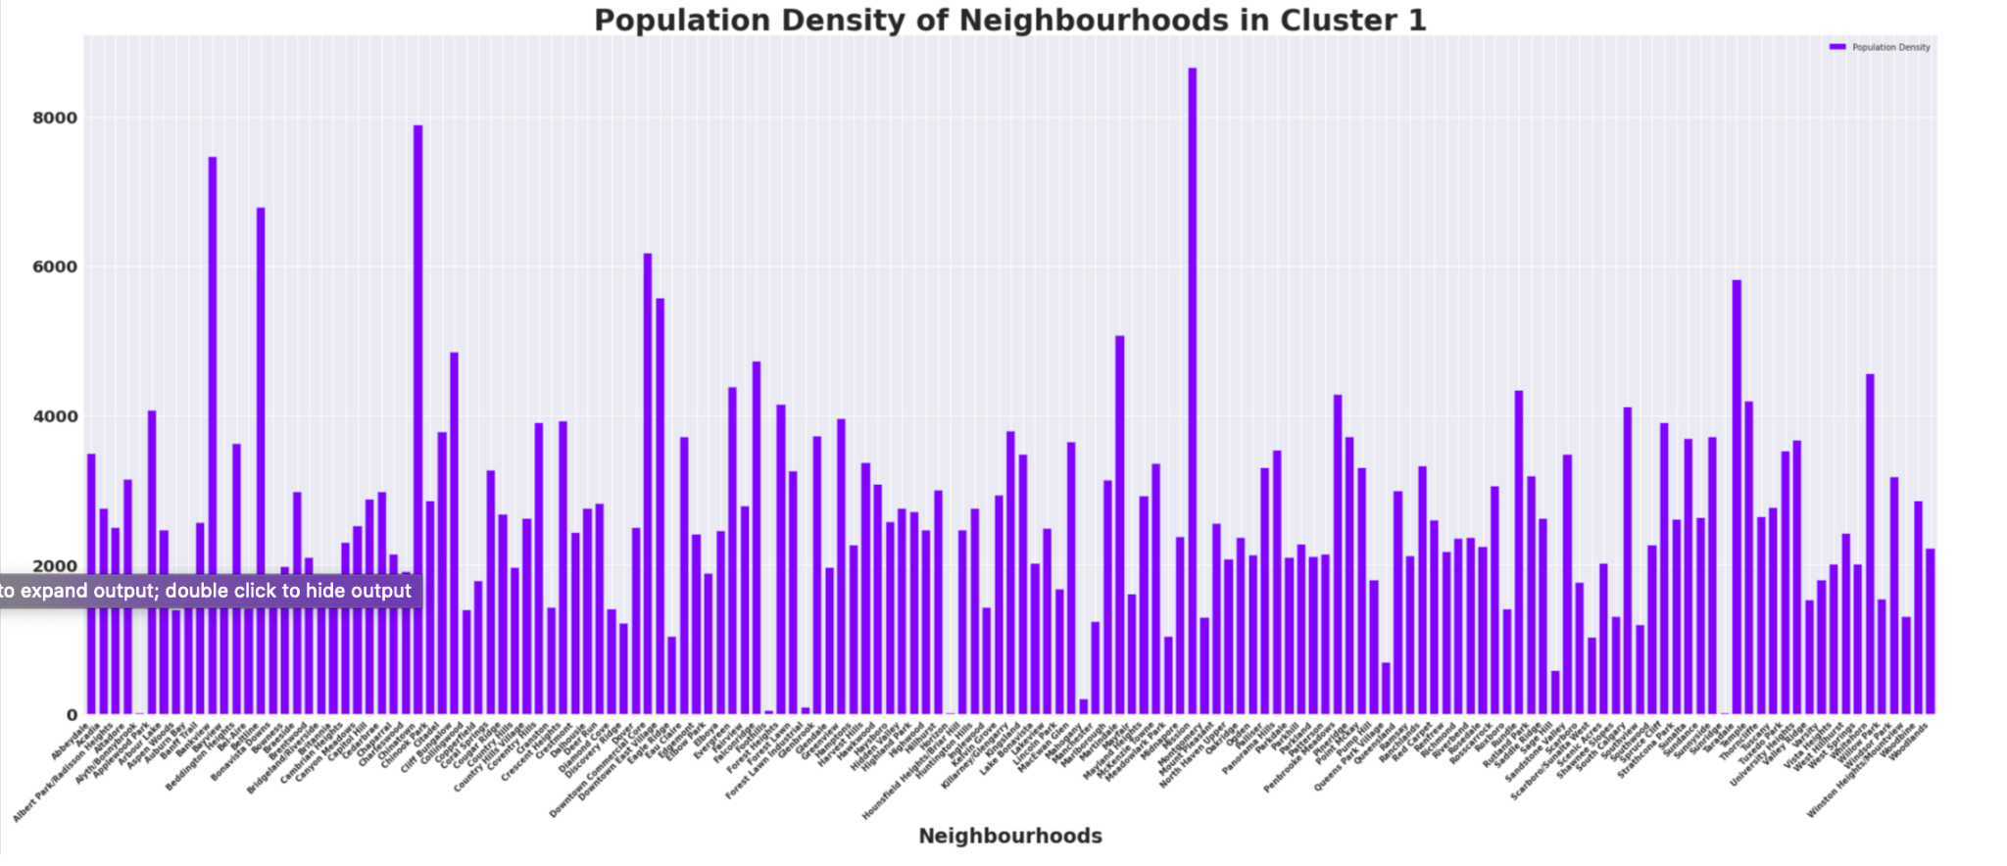
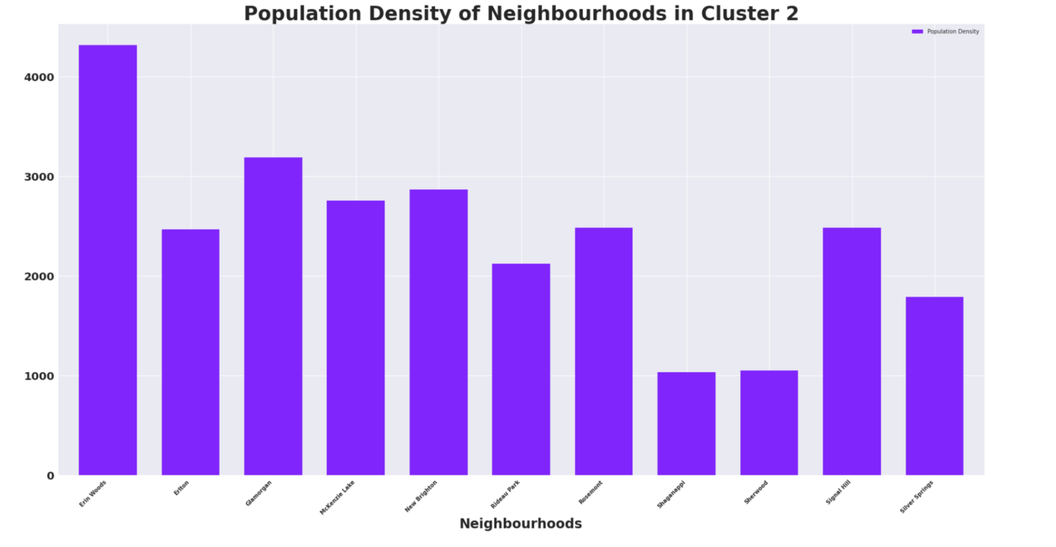
Results: Population Density
Population density
Also a major factor when determining which neighbourhood to settle in
Is the concentration of individuals within a specific geographic locale
Cluster 1:
indicates a high traffic count in cluster 1 as majority of the neighbourhoods exceed the 3000 mark
appropriate for individuals looking to maintain an engaging lifestyle
Cluster 2:
Relatively lower rates than cluster 1
Appropriate for individuals looking for a relatively quiet lifestyle

Slide 11
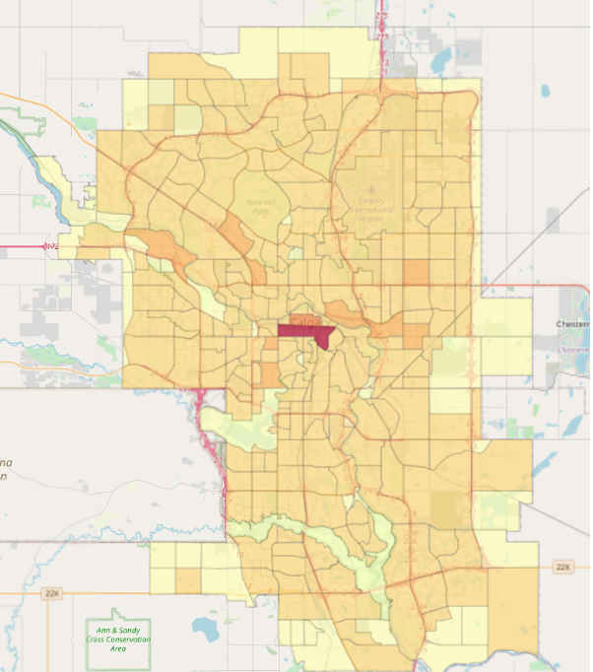
Results: Crime Data
Choropleth crime map indicates a fairly uniform crime rate
Highest: city centre
Neighbourhood: Beltline part of cluster 1
Lowest: outskirts of Calgary
Randomly dispersed clusters indicate zero correlation between the two variables, crime rate and clusters

Slide 12
Limitations and Suggestions for Future Studies
Other criteria may need to be factored in:
Property value and census by age
Such data are not readily available and attainable to the neighbourhood level required
Limitations to the “free” foursquare plan:
Sandbox Tier account only allowed a certain number of API calls to be made, enabling the capture of precise data.

Slide 13
Conclusion
Findings indicate that the two clusters identified, along with the other two sets of data have little correlation and thus can not be used exclusively to differentiate clusters
General assumption:
Cluster 1 is appropriate for younger individuals seeking an active lifestyle open to new experiences
Cluster 2 for families who prefer the quiet and conventional lifestyle.

